Slide 1
Everything You Always Wanted to Know About the NEW English SOL

Slide 2
2010 English Standards of Learning Schedule of Implementation
2011-2012 – SOL Field tested items aligned to the 2010 English Standards of Learning
February – April, 2012 – SOL Online Writing Field Test for grades 5, 8, and End-of-Course (EOC)
Fall 2012 - Full implementation of new SOL (EOC Reading)
Spring 2013 - Full implementation of new SOL (3-8, EOC Reading; 5, 8, EOC Writing)

Slide 3
Grades 4-12 Reading Strand
There is strong vertical alignment in grades 4-12
Reading is divided into fiction and nonfiction strands
Research will be tested in writing instead of reading
The SOL Reading Tests Reporting Categories include:
Word Analysis and Word Reference
Comprehension of Fiction
Comprehension of Nonfiction

Slide 4
Grades 4-12 Reading Strand Vocabulary Standards
Vocabulary standards appear as the first standard in the Reading Strand in grades 4-12
Instruction should emphasize common Greek and Latin roots and affixes
Instruction should include word study in authentic texts and differentiation between denotation and connotation
SOL assessments will test vocabulary in passages and stand-alone items

Slide 5
Grades 4-12 Reading Strand
Grades 6-12 Standards include a comparison of forms and genres including fiction and nonfiction texts with a similar topic or theme (poetry)
Nonfiction reading includes emphasis on text structures and organizational patterns
More nonfiction than fiction questions appear on SOL reading test in grades 5 – 12

Slide 6
4-12 Reading Blueprints
Notes:
5.

Slide 7
Grade 3 Reading
2012-2013 SOL Test
2009-2010 SOL Test
Notes:
Note the difference in the sample items. In the old version, students had to choose the correct answer. In the new TEI sample, students must drag and drop all 4 answers to the proper place in the Venn diagram.

Slide 8
Grade 8 Reading
2012-2013 SOL Test
2009-2010 SOL Test
Notes:
The previous version of the Grade 8 Reading test required students to choose the answer that belonged in the empty box. The new TEI requires students to drag and drop the correct phrase into the proper place on the flow chart. Notice there are only 3 spots on the flow chart and 5 phrases.

Slide 9
EOC Reading
2012-2013 SOL Test
2009-2010 SOL Test
Notes:
The TEI item here asks students to click on the 3 words that convey the author’s intent to capture the sense of beauty and joy; there are 10 highlighted words.

Slide 10
Grades 4-12 Writing Strand
Writing revolves around mode, purpose, audience, and process
Each grade level has a composing/revision standard and an editing/grammar standard
Emphasis is put on elaboration, unity, central idea, organization, tone, and voice

Slide 11
Grades 4-12 Writing Strand
Teaching writing is an expectation of every grade, not only “tested” grades
Provide students with opportunities to compose using computer technology and to use the Online Practice SOL Writing Tool (no prompts provided)
Self- and peer-editing opportunities for students are essential
SOL writing does not require 5 paragraphs

Slide 12
Changes to SOL Writing Tests
The End-of-Course prompt - persuasive
Grade 8 prompt - persuasive or expository
Grade 5 prompt - expository or narrative
Composing/Written Expression is now one combined domain

Slide 13
SOL Two Domain Writing Rubric (EOC)
Composing/Written Expression
Audience/purpose
Central Idea
Effective conclusions
Counter arguments
Elaboration
Unity
Organization
Deliberate Word Choice
Selected, Precise Information
Sentence Variety
Tone
Voice
Usage & Mechanics
Sentence Formation
Usage
Standard Inflections
Comparison of Adjectives and Adverbs
Agreement
Mechanics
Capitalization
Spelling
Punctuation
Formatting

Slide 14
Scoring with the SOL Writing Rubric
All student papers are read by two readers; their scores are added together
Composing/Written Expression score counts twice = 2/3
Usage/Mechanics score counts once = 1/3
If judges scores are more than 1 point apart, papers are read by a third judge

Slide 15
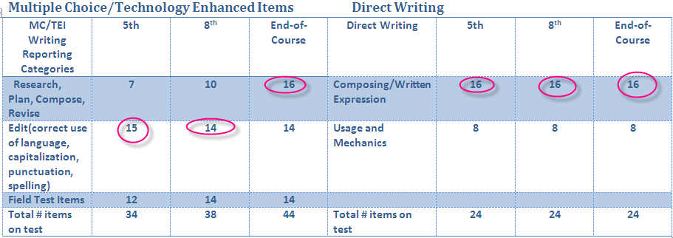
SOL Writing Blueprints
Notes:
Notice the end-of-course writing assessment has more questions in the Research, Plan, Compose, Revise reporting category, while both the grade 5 and 8 assessments have emphasis ( points) in the Editing reporting category.

Slide 16
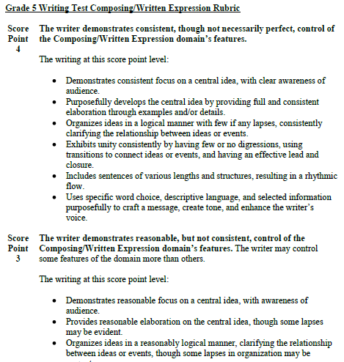
Writing Rubrics

Slide 17
Grade 5 Writing
2012-2013 SOL Test
2009-2010 SOL Test
Notes:
The new Grade 5 SOL Writing Assessment requires students to drag and drop the comma into the correct places; there may be more than one correct location.

Slide 18
Grade 8 Writing
2012-2013 SOL Test
2009-2010 SOL Test
Notes:
In the previous version of the Grade 8 test, students were required to fix a comma error. The new version requires students to identify and fix an error in a sentence. These error choices include: plural possessives, comma splice, subject-verb agreement, and homonyms.

Slide 19
EOC Writing
2012-2013 SOL Test
2009-2010 SOL Test
Notes:
In this EOC Writing TEI item, students are required to drag and drop the correct punctuation mark into the correct location; all hot spots may not require punctuation, and all punctuation marks may not be used. Punctuation marks may be used more than once. In the previous version, students had to choose the correct answer from 4 choices.

Slide 20
Grades 4-12 Research Strand
Consequences of plagiarism, following ethical and legal guidelines for gathering and using information is emphasized in grades 3-12
Students conduct research projects in grades 4 and 5
Citation of primary and secondary sources begins in grade 6
MLA or APA documentation is required in grades 9-12

Slide 21
Grades 4-12 Research Strand
Students are expected to:
Critically evaluate the accuracy, quality, and validity of the information
Frame, analyze, and synthesize information to solve problems, answer questions, and generate new knowledge
Each research “product” does not have to be a paper
Media Literacy can easily be incorporated into research

Slide 22
Communication: Speaking, Listening, and Media Literacy
Replaces the Oral Language strand in grades 4-12
Instruction should include opportunities for student collaboration and promote active listening skills
Emphasis is on critical thinking, problem solving, accountability, working in groups, and reaching consensus

Slide 23
Communication: Speaking, Listening, and Media Literacy
Students are expected to:
Identify author, audience, content, and purpose of media messages
Compare/contrast auditory, visual, and written media messages
Identify persuasive techniques in media messages
Distinguish between fact and opinion in media messages and text

Slide 24
SOL Assessment Notes
Late fall 2012 – Additional practice items for EOC reading released
Late fall 2012 – Paired passage demonstration released, VMAST blueprints released
Spring 2013 – Additional practice items for 3-8 reading released
Late fall 2012 – List of approved prompts for 5, 8, and EOC writing released
Spring 2015 – English SOL tests will be released

Slide 25
SOL Assessment Notes
15% of the reading/writing tests will be TEI
Emphasis words (most, main, best) will not be emphasized on any SOL test
NOT and EXCEPT will continue to be emphasized except on grade 3 reading
Grade 3 Reading Test will not contain any items emphasizing the words NOT or EXCEPT
Grade 3-5 Reading Tests will test cross-curricular words (3.4f example: sediment)

Slide 26
SOL Assessment Notes
Grade 3 Research is tested in Reading
(3.7 a-b comprehension of print and electronic resources)
Direct Writing is online; students MAY use scratch paper
EOC Writing Rubric is mode specific -persuasive

Slide 27
What is the VMAST?
An alternate assessment based on modified achievement standards
“Modified” does not mean that the content is modified. Items are based on grade level content
Only available in online delivery
Maintains test constructs, but is less difficult than the SOL assessments
Is 20% shorter than SOL assessments
VMAST is available only through 2013-2014

Slide 28
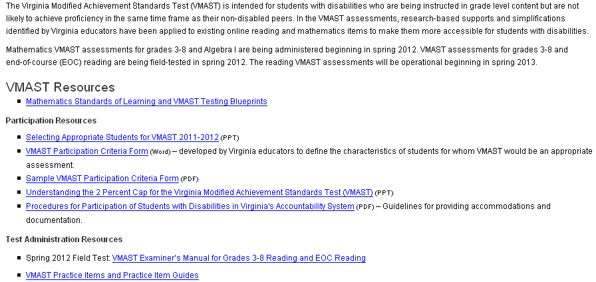
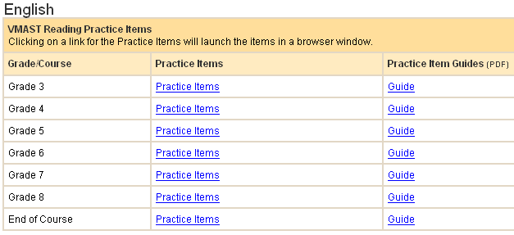
VMAST
Notes:
VDOE VMAST resources are available online. Practice test items and practice guides may be of particular importance to special educators. Sample participation form might be helpful too.
The VMAST is an online grade level alternate assessment designed for a small group of students with disabilities. Students participating in the VMAST are expected to learn grade level content; however, they may require additional time and a variety of instructional and assessment supports. Students participating in the VMAST do not receive a modified curriculum; the achievement expectations are modified and rigor is reduced by including supports and simplifications that allow participating students to access and demonstrate knowledge of grade level content. Eligibility must be determined separately for mathematics and reading.
Links:
http://www.doe.virginia.gov/testing/alternative_assessments/vmast_va_mod_achievement_stds_test/practice_items/index.shtml
http://www.doe.virginia.gov/testing/alternative_assessments/vmast_va_mod_achievement_stds_test/index.shtml

Slide 29
2010 English Standards of Learning Web Page

Slide 30
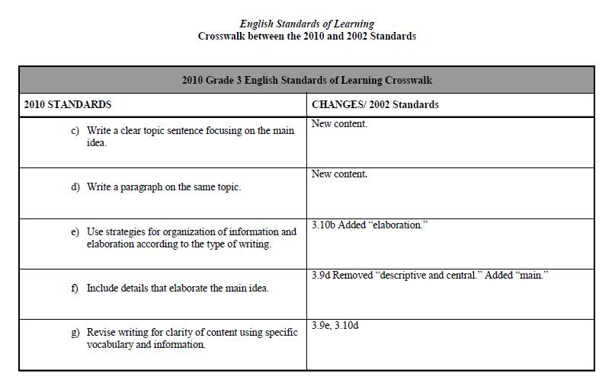
SOL Crosswalk

Slide 31
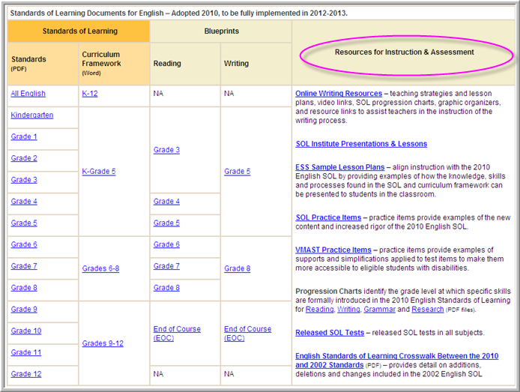
Resources

Slide 32
SOL Progression Charts Writing

Slide 33
SOL Progression Charts Reading

Slide 34
SOL Progression Charts Grammar

Slide 35
SOL Progression Charts Research

Slide 36
Enhanced Scope and Sequence
Provides teachers with sample lesson plans aligned with the Curriculum Framework
Lesson plans presented for oral language, communication, reading, writing, and research
Lessons are available in a drop-down menu by grade band and strand

Slide 37
Enhanced Scope and Sequence

Slide 38
English SOL Institutes Resources

Slide 39
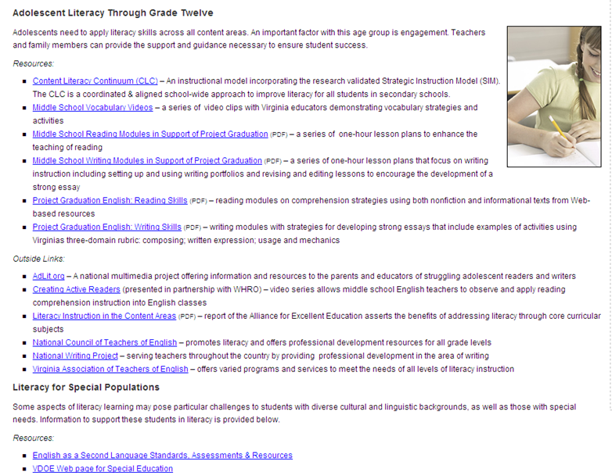
Literacy Web Page

Slide 40
Online Writing Web Page

Slide 41
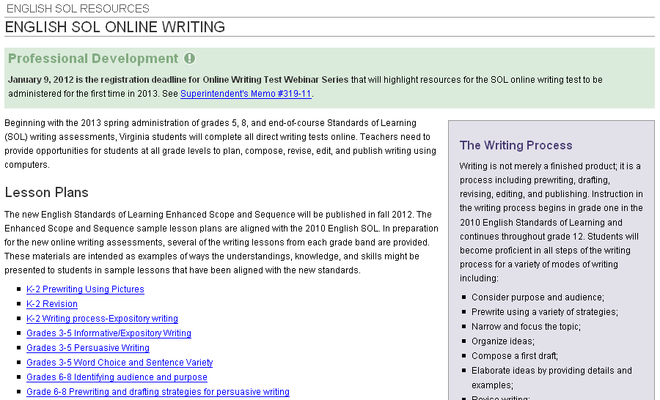
Online Writing Web Page

Slide 42
Writing Resources
Downloadable Writing Process graphic

Slide 43
Graphic Organizers
Clustering
Process
Comparison / Contrast
Order Importance
Sensory Chart
Connected Relationships
Persuasive Paper Checklist

Slide 44
Online Writing Practice Tool
Typing Tools
Typing Tools
Current Line Location
Progress Bar

Slide 45
Blueprints

Slide 46
Formative Assessment
Pull passages from content texts
Punctuate the text
Ask reading
comprehension questions
Include vocabulary
Include short essay questions

Slide 47
Teacher Direct

Slide 48
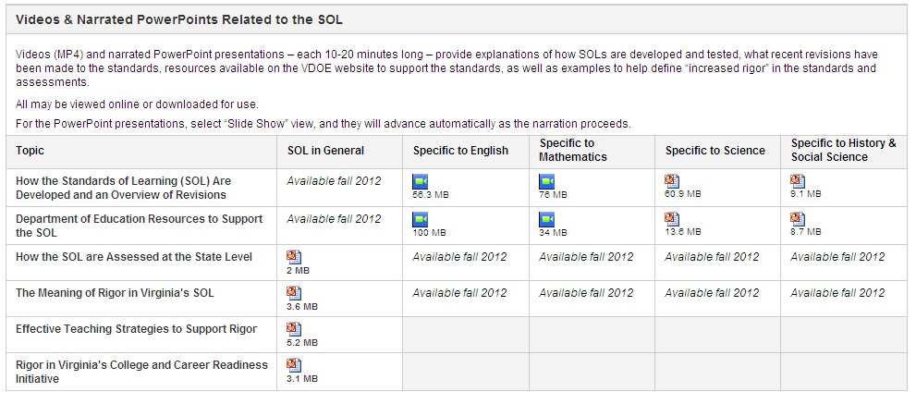
Teacher Direct

Slide 49
In Summary
Review Vertical Alignment
Teach Nonfiction
Pair Passages
Teach Roots and Affixes
Teach Composing Online
Offer Students Choices (reading & writing)
Integrate All Strands

Slide 50
Contact Information
Tracy Fair Robertson
English Coordinator
Tracy.Robertson@doe.virginia.gov
804-371-7585
Assessment Office
Student_assessment@doe.virginia.gov
804-225-2102
Virginia Department of Education
Notes:
TR

